Slide 1


20. Mental Health
Session V: Mental and Physical Health

Slide 2
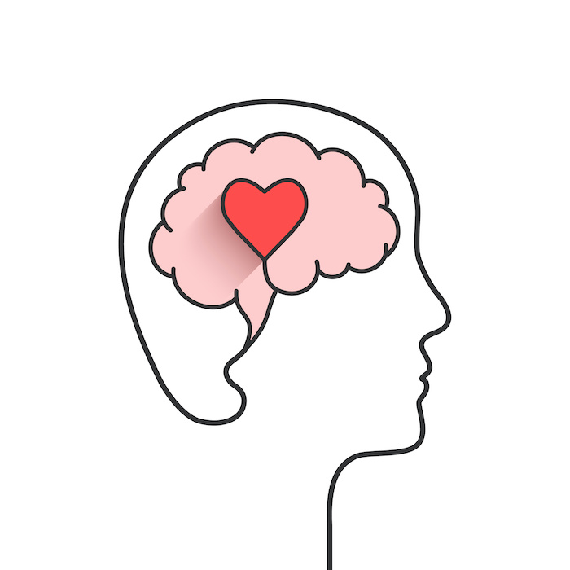
Chapter outlines
1. Mental Health Basics
2. Depression
3. Loneliness

Slide 3
LEARNING OBJECTIVES
By the end of this section, you will be able to:
Identify the difference between occasional negative emotions and more serious mental health issues, such as anxiety disorder or depression
Explore practices for ensuring mental health and emotional balance in your life
Identify resources for further information and guidance about mental health issues

Slide 4

It is only in sorrow bad weather masters us; in joy we face the storm and defy it. —Amelia Barr, British author

Slide 5

1. Mental Health Basics
Knowing how to take care of your mental health when you’re in college is just as important as maintaining your physical health.
Doctors are finding that positive mental health can actually improve your physical health.

Slide 6
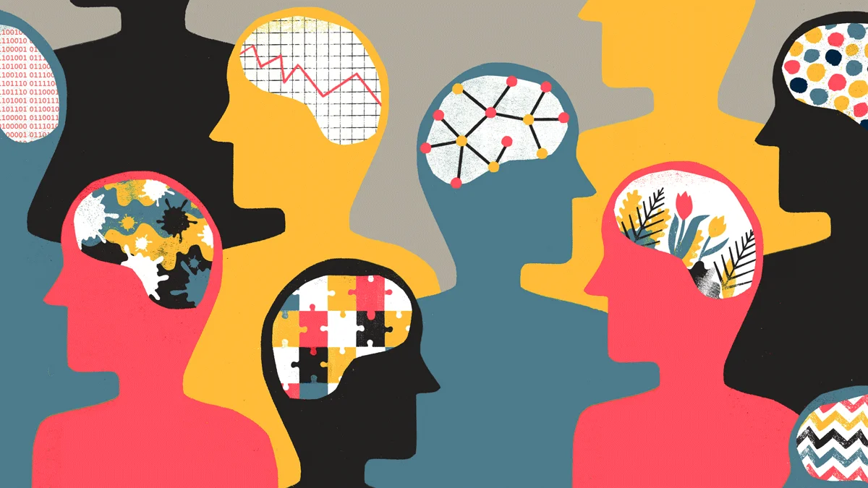
What is “mental health”?
A state of well-being in which the individual realizes his or her own abilities, can cope with the normal stresses of life, can work productively and fruitfully, and is able to make a contribution to his or her community.
Having good mental health doesn’t necessarily mean being happy or successful all the time

Slide 7
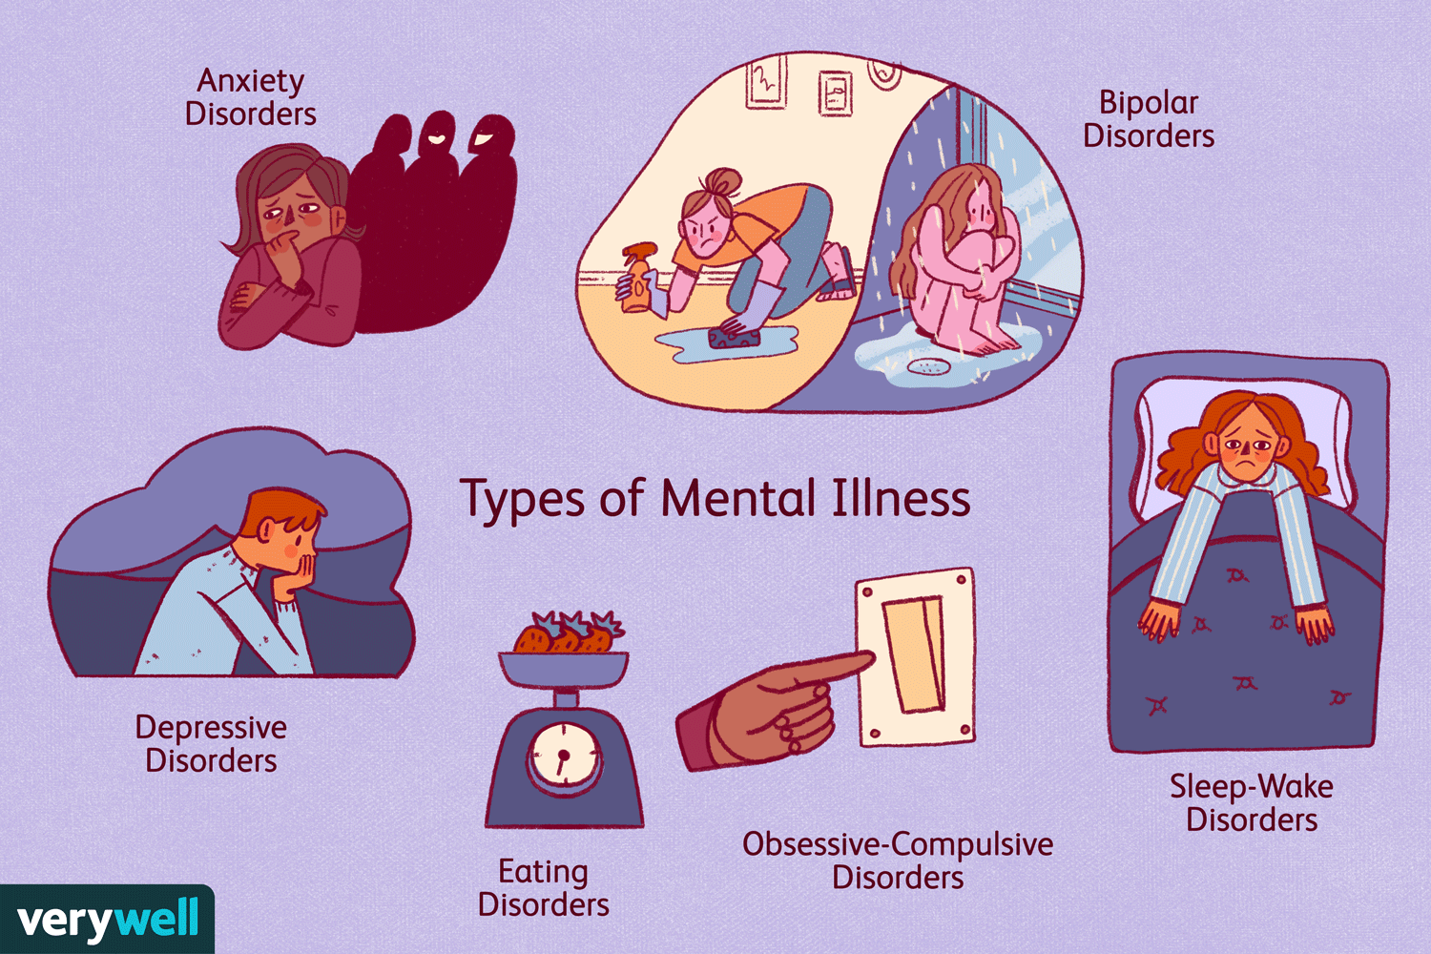
Mental illness
Refers to mental disorders or health conditions characterized by “alterations in thinking, mood, or behavior (or some combination thereof) associated with distress and/or impaired functioning

Slide 8

Depression is the most common type of mental illness
It affects more than 26 percent of the U.S. adult population (2020)
Depression will be the second leading cause of disability throughout the world, trailing only ischemic heart disease.

Slide 9
Affects
Evidence has shown that mental disorders, especially depressive disorders, are strongly linked to the occurrence and course of many chronic diseases.
If your mental health is poor, you may be at greater risk for disease and poor physical health.
Diabetes
Cancer
Cardiovascular disease
Asthma,
and obesity and many risk behaviors for chronic disease

Slide 10
Mental Health Indicators
Emotional well-being: life satisfaction, happiness, cheerfulness, peacefulness.
Psychological well-being: self-acceptance, personal growth including openness to new experiences, optimism, hopefulness, purpose in life, control of one’s environment, spirituality, self-direction, and positive relationships.
Social well-being: social acceptance, belief in the potential of people and society as a whole, personal self-worth and usefulness to society, and a sense of community.

Slide 11
The strategies one uses to improve your emotional, psychological, and social health:
Eat a balanced diet
Get enough sleep
Get regular physical activity
Stay socially connected with friends and family
Make smart choices about alcohol and drugs
Get help if you are anxious or depressed
There are also some common-sense strategies that you can adopt to support and improve your emotional, psychological, and social health.
Not surprisingly, they are very similar to the strategies one uses to cope with stress:

Slide 12
2. Depression
Depression is a common but serious mood disorder that’s more than just a feeling of “being down in the dumps” or “blue” for a few days.
It causes severe symptoms that affect how you feel, think, and handle daily activities, such as sleeping, eating, or working. To be diagnosed with depression, the symptoms must be present for at least two weeks.

Slide 13
If you have been experiencing some of the following signs and symptoms most of the day, nearly every day, for at least two weeks, you may be suffering from depression:
Persistent sad, anxious, or “empty” mood
Feelings of hopelessness, or pessimism
Irritability
Feelings of guilt, worthlessness, or helplessness
Loss of interest or pleasure in hobbies and activities
Decreased energy or fatigue
Moving or talking more slowly
Feeling restless or having trouble sitting still
Difficulty concentrating, remembering, or making decisions
Difficulty sleeping, early-morning awakening, or oversleeping
Appetite and/or weight changes
Thoughts of death or suicide, or suicide attempts
Aches or pains, headaches, cramps, or digestive problems without a clear physical cause and/or that do not ease even with treatment

Slide 14

3. Loneliness
Most people experience occasional loneliness, and it’s an especially common experience among first-time college students, who find themselves in an unfamiliar environment with a completely new social scene.

Slide 15

Loneliness
Loneliness isn’t necessarily about being alone—you can be surrounded by people and still feel alone. It’s the feeling of being alone that counts, along with feeling empty, unwanted, or isolated.

Slide 16
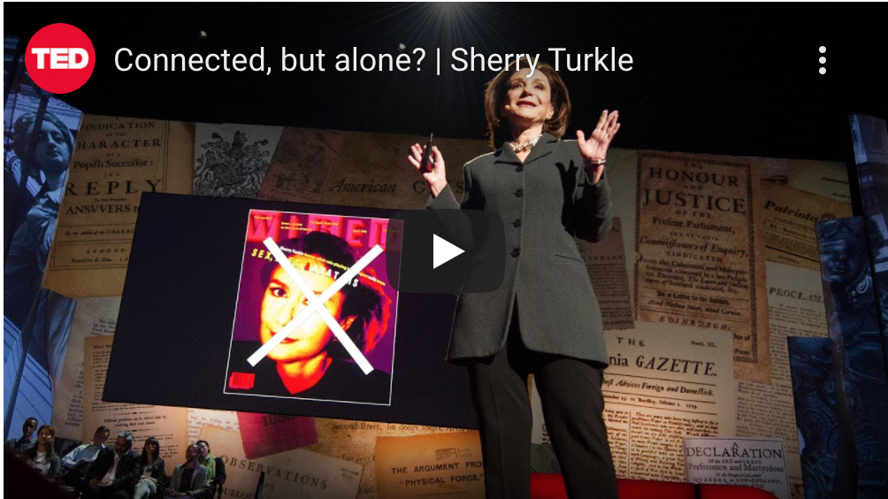
Video clip: Connected, but alone?
Ted Talk, Sherrie Turkle describes how, in this age of near-constant digital “connection,” loneliness is a challenge that faces us all:

Slide 17
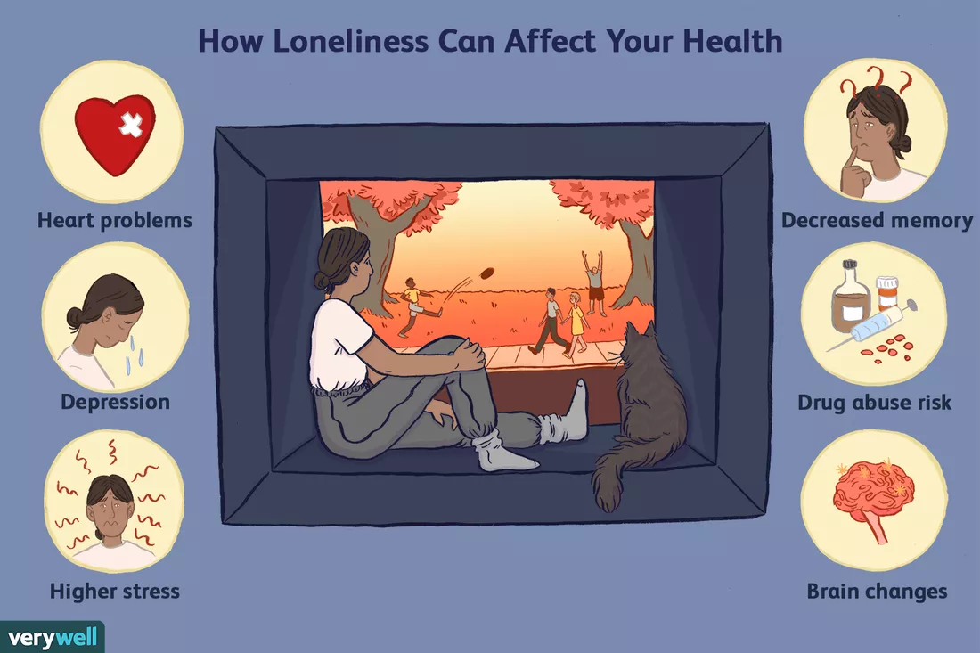

Slide 18

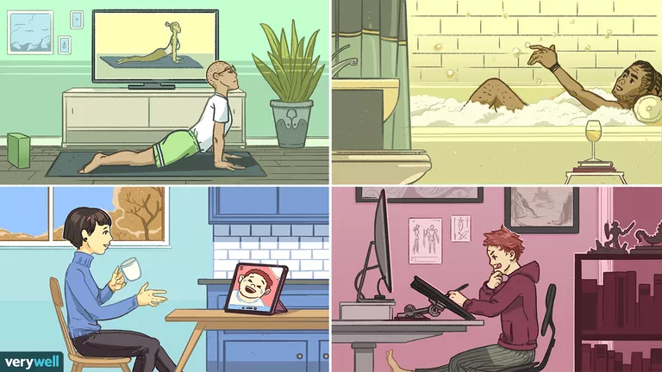
If you’re feeling lonely, try taking and start a conversation with someone.
College is a great place to meet new people and develop new and interesting relationships.
Try joining a campus interest group or club, play a team sport, or just ask another student if they’d like to meet for coffee or to study.

Slide 19
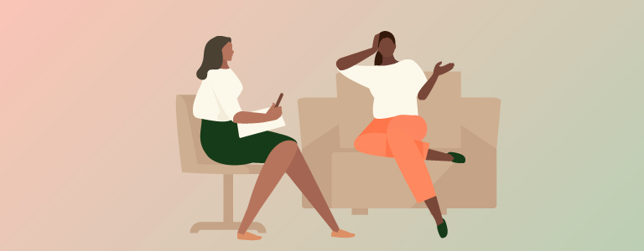
If feelings of loneliness persist, and especially if you also feel depressed, you should get help from a counselor or health services.

Slide 20

Activity: Relaxation

Slide 21


